Slide 1
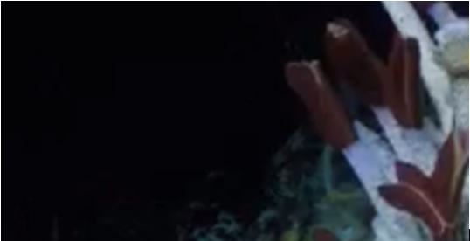
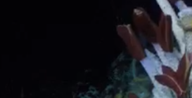
Instance Segmentation for Biogeography
Melissa Parkhurst, Jnaneshwar Das, Harish Anand, and Elizabeth Trembath-Reichert
NASA Space Grant
School of Earth and Space Exploration
Center for Global Discovery and Conservation Science

Slide 2
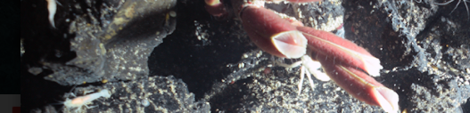
Introduction
Questions about:
  How many species are present?
  How big are their populations?
  What are their spatial distributions around the vents?
Current study is done through trawling and manned and unmanned vehicles (Tunnicliffe, McHugh, & McArthur, 1998; Zhou et al., 2018)

Slide 3
Ideas
Current challenges:
  Data hard to be obtained (expensive!)
  Time consuming & tedious to process data
Solution:
  Use existing footage
  Train a neural network to process the data for us!

Slide 4
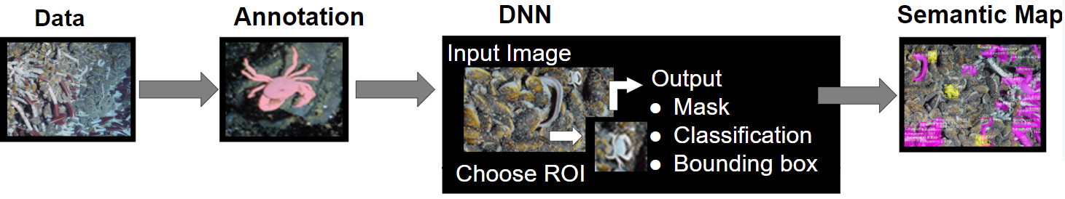
Methods
Six categories of organisms:
  Crabs and lobsters
  Fish
  Tubeworm (divided into plume and tube sections)
  Shrimp
  Anemones
  Other.
Annotated expedition dataset
Deep neural network (DNN) Mask R-CNN
Training carried out on 60% of the annotated data used to make predictions on the rest of the data.
Notes:
Training carried out on 60% of the annotated data for 12 iterations with highest score for correct segmentations manually selected to make predictions on the rest of the data.

Slide 5
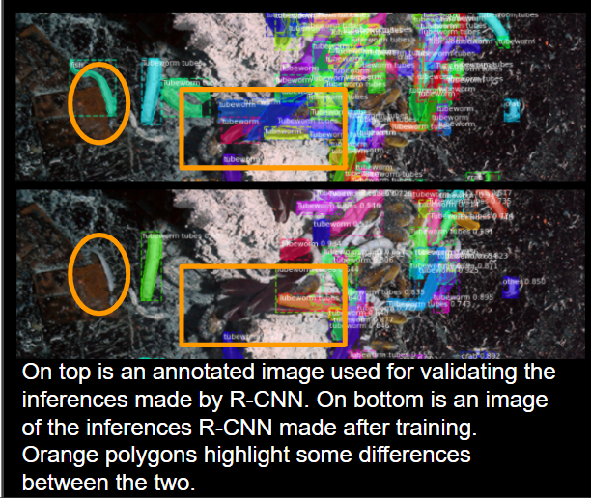
Results
Predictions by the Mask R-CNN model show variations in accuracy among the categories.
Crabs and lobsters, tubeworm plumes and other were the most accurately predicted.
Tubeworm tubes were under predicted and sometimes confused with fish.
Initial training by R-CNN has depended on a rather small subset of annotated images (38 images ranging from 1 to over 200 annotations per image), and accuracy is expected to rise as more annotations are added to training.

Slide 6
Conclusions
Not time-effective for small studies
  Unless annotation database already exists
  Accuracy needed is low
Effective for large studies:
  Spatial
  Temporal
Most accurate for organisms that are more visible against natural background, such as crabs.

Slide 7
Next Steps
Add more annotated images to the predictive model to increase the accuracy of inferences.

Slide 8

Acknowledgements
This work was supported in part by NASA STTR award 19-1-T4.01-2855.
All images used and shown are from the Nautilus 2018 Lo`ihi Seamount expedition, Copyright WHOI 2018, NDSF, Alvin Group, NDSF, NSF Cruise AT42-06 Co-Chiefs Trembath-Reichert and Parnell-Turner,
References
Tunnicliffe, V., McHugh, D., & McArthur, A. (1998). A Biogeographical Perspective of the Deep-Sea Hydrothermal Vent Fauna. Advances in Marine Biology, 34, 353-442.
Zhou, Y., Zhang, D., Zhang, R., Liu, Z., Tao, C., Lu, B., . . . Wang, C. (2018). Characterization of vent fauna at three hydrothermal vent fields on the Southwest Indian Ridge: Implications for biogeography and interannual dynamics on ultraslow-spreading ridges. Deep Sea Research Part I: Oceanographic Research Papers, 137(July), 1-12.
Go to nasa.asu.edu for more information

Slide 9
Thank You

Slide 10
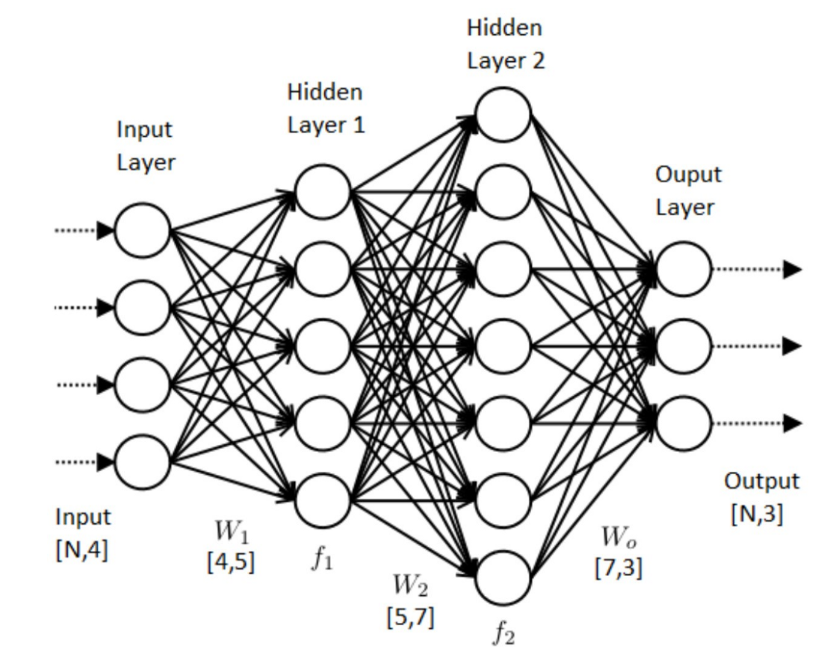
Neural Networks
Ahire, J. (2020, September 01). The artificial neural networks handbook: Part 1. Retrieved February 17, 2021, from https://medium.com/coinmonks/the-artificial-neural-networks-handbook-part-1-f9ceb0e376b4

